Slide 1
Project Overview
Time Sheet Management System Gestalt Technology Services
Venkat, Vishnu, Sreenu and Sada

Slide 2
Project Goals
For the successful completion of a Project management plays a crucial role.
One among several tools available is ProMis developed by GTS and delivered it to an U.S. based firm for an sum of 80,000 $ U.S.
Our project TSM System is a module of ProMis inheriting the subset of functionalities of ProMis.

Slide 3
Abstract
Time Sheet management System (TSM) is a module of the Project Management System. TSM system focuses on the management of proper flow of work as per time and the successful completion of the project with in the estimated time. The users of this management system are from various authentication levels right from project manager to developers. So many features of the system are inactive to some users basing on their authentication levels.
The TSM system starts with a login screen querying
for username and password. And basing upon the user logged on, the system will respond with appropriate menu items active and some inactive. The system should provide this user privilege and basing on the user master table contents. The system should provide the flexibility in changing the password of a particular user.

Slide 4
Work Completed so Far
➢ The Designing of the Front End (User Interfaces) and the Back End (Database Tables)
  The Design of the front end interfaces and various constraints for that are analyzed as well as designed
  The design of Back End Table structures and various constraints are analyzed as well as designed
➢ The Implementation of the Front End and the Back End.
  We have employed Javax Swings package for the implementation of interfaces as well as for the establishment of various constraints for front end implementation.
  Thinking from the portability point of view we have up to now employed the Microsoft Access as the Back End for our Project and we can even implement it in Oracle.

Slide 5
Users of TSM System
Project Managers
Project Leaders
Developers

Slide 6
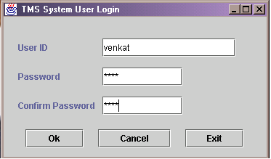
Login Window

Slide 7
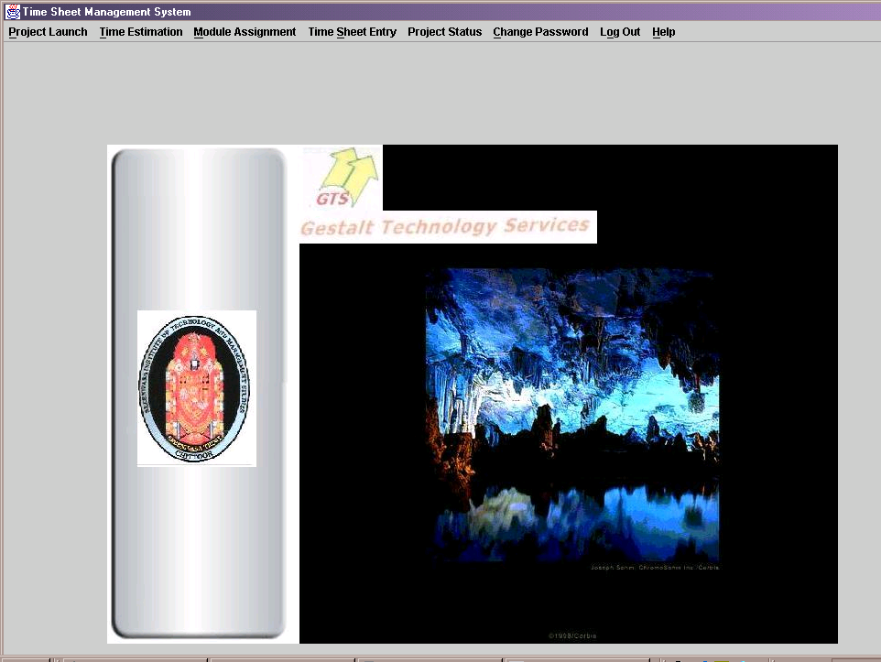
Main Window Frame

Slide 8
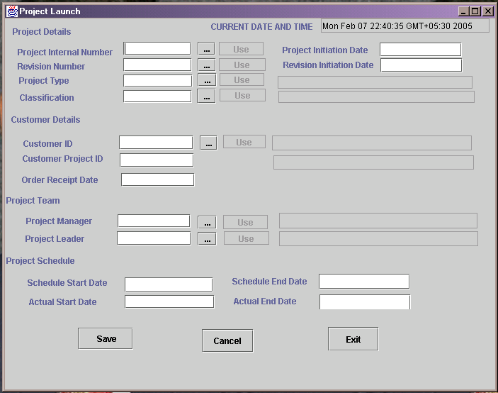
Project Launch Frame

Slide 9
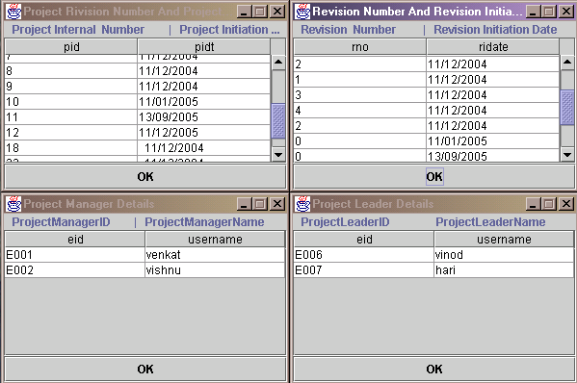
Common Double Sub Frame

Slide 10
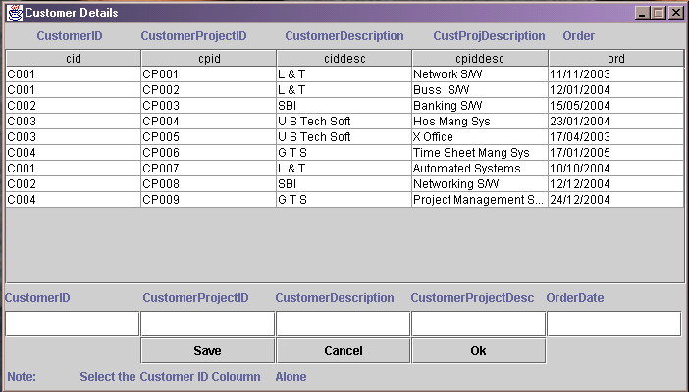
Customer Details Sub Frame

Slide 11
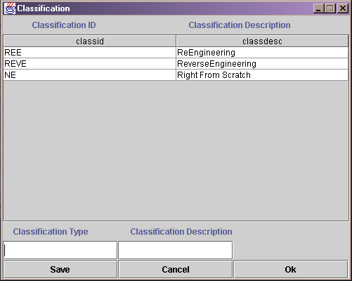
Classification Sub Frame

Slide 12
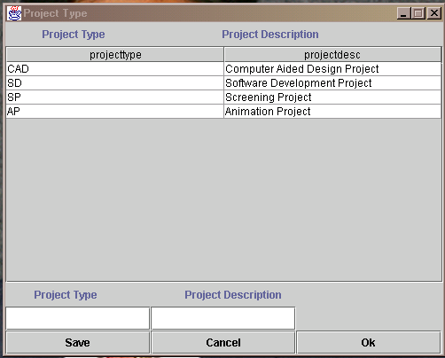
Project Type Sub Frame

Slide 13
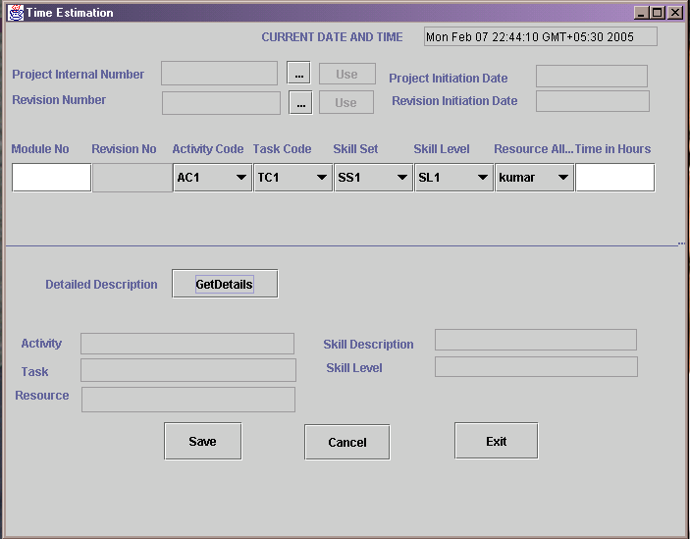
Time Estimation Frame

Slide 14
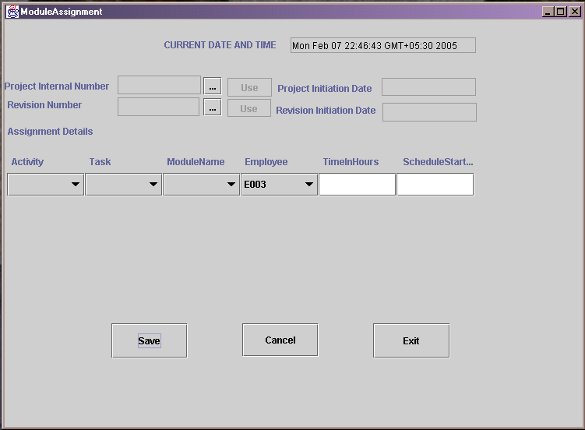
Module Assignment Frame
Phase 1
Phase 2
Phase 3
Jan
Feb
Mar
Apr
May
Jun
July
Sep
Oct
Nov
Dec

Slide 15
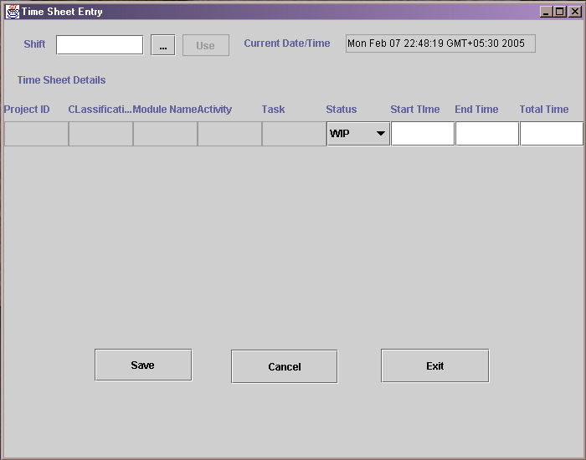
Time Sheet Entry Frame

Slide 16
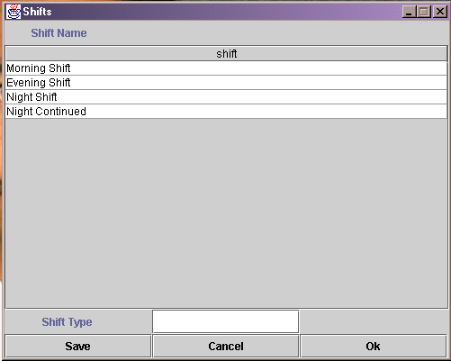
Shifts Sub Frame

Slide 17
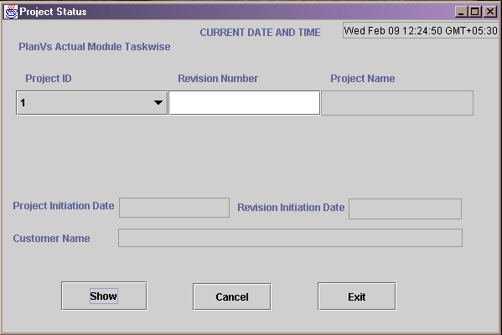
Project Status Frame

Slide 18
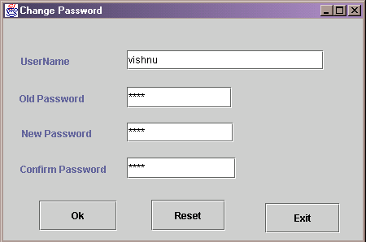
Change Password Frame

Slide 19
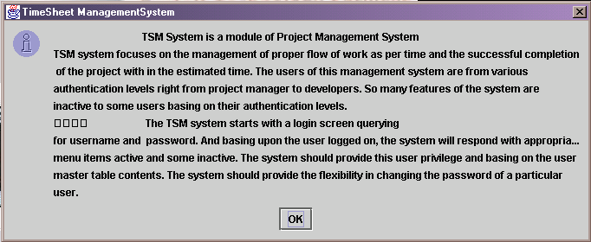
Help

Slide 20
Data Base Tables Used
The final Database Tables we have got up to now are:
➢ Launch – (pid, pidt, rno, ridate, ptype, clid, cid, cpid, piddes, resdt, pmid, plid,pmname, plname, ssdt, sedt, asdt, aedt).
➢ Customer details – (cid, cpid, ciddesc, cpiddesc, ord).
➢ Classification – (classid, classdesc).
➢ Project type – (project type, project desc).

Slide 21
Continued…..
➢ Moduleassignment – (pid, acode, tcode, mname, eid, time, ssdt, status).
➢ Shifts – (shift).
➢ Usermaster – (eid, username, pwd, ua).
➢ Timeestimation – (pid, mname,rno, acode, tcode, scode, rescode, time).
➢ Timesheetentry – (eid, shift, PID, mname, status, starttime, endtime, totaltime).

Slide 22
Work Remaining
Work To Be Completed :
♦ Testing the module for various inputs and analyzing the correctness of the outputs.
♦ Documentation and Maintenance of the TSM system as a part of Project Management System.

